Slide 1
Chicago Crime Analysis By Pranav Killedar

Slide 2
Problem Statement :-
One year ago, the city of Chicago faced a surge in crime rates, prompting the government to respond swiftly. In a bid to tackle the issue head-on, they initiated an operation involving the deployment of highly skilled police officers. Now, with twelve months having elapsed since the implementation of this operation, the authorities are keen to assess its impact. They aim to gauge the effectiveness of this initiative by analyzing the reduction in crime incidents and identifying any notable advantages gained from the presence of these top-performing officers.

Slide 3
Data Overview :-
01
02
03
04
Dataset: Incident records with key attributes like ID, Date, Type, Location, Arrest, Domestic, etc.
Exploration: Insights into crime types, locations, and temporal trends.
Quality: Addressing missing values, consistency checks, and validating geographic coordinates.
Metrics: Incident count, arrest rate, domestic incident rate, location distribution, crime categories.

Slide 4
Methodology :-
Data Cleaning: Utilized Power BI Query Editor for data cleaning, ensuring accuracy and consistency.
Column Creation: Employed DAX formulas to create additional columns for enhanced analysis.
Advanced DAX Measures: Developed advanced DAX measures to derive insights and support analytical requirements.
Visual Creation: Utilized Power BI's visualization tools to create intuitive visuals for better understanding and analysis of the data.

Slide 5
Analysis of Objective Questions :-
- Data Cleaning: Eliminated null values and introduced new columns using DAX formulas.
- Crime Type Analysis: Identified theft as the most prevalent crime category.
- Arrest Rate Evaluation: Determined an arrest rate of 12.42%.
- District Crime Distribution Assessment: Noted District 6 as having the highest number of reported incidents.
- Categorical Attributes: Identified several categorical columns for further analysis.
- Handling Null Values: Removed null values from the X and Y coordinate columns.
- Domestic Crime Proportion Analysis: Found domestic crimes accounted for 20.02% of total offenses.
- Location Description Analysis: Highlighted apartment locations as having the highest crime frequency.
- Average Time to Resolve Cases: Calculated an average resolution time of 9.03 days.
- Patrol Area Analysis: Identified Beat 511 as having relatively low crime incidence.
- Calculated Columns vs. Add Columns: Utilized DAX formulas for calculated columns and Power Query Editor for additional columns.
- Using Calculate and Row Iteration: Employed these methods to calculate theft crimes in District 8.
- Separating Longitude and Latitude: Split longitude and latitude values using the 'Add Column with Example' feature.
- M Language in Power Query: Utilized M-query for data transformation tasks in Power Query Editor.

Slide 6
Analysis of Subjective Questions :-
- Crime rates experienced monthly fluctuations, with a notable decrease observed in June.
- Crime reduction strategies encompassed policing efforts, community engagement initiatives, and addressing root causes.
- Tailored interventions are essential for addressing crime in high-risk areas like Apartment Street.
- Wards 42, 27, 28, 6, and 24 necessitate security enhancements to curb crime effectively.
- Variability in crime rates across different months and days emphasizes the importance of proactive measures.
- Arrest rates for domestic crimes were found to be distressingly low, indicating a significant challenge for law enforcement.
- Analysis of common terms in crime descriptions provided valuable insights into prevalent crime types.
- Resolution times for criminal cases varied based on the type of crime and its location.
- Theft emerged as the most prevalent crime type, followed by battery and criminal damage incidents.
- Utilizing the Power BI Gateway ensures secure data access and enables real-time analytics.
- A many-to-one relationship was identified between districts in crime data and district_ids in a separate table, illustrating relational complexity within the dataset.

Slide 7
Important Analysis :-
Best Patrol Office - 511
Theft type crime – 19,766
May Month – 19,353
The data analysis yields crucial findings: Patrol Officer 511 handles fewer cases; theft emerges as the primary offense; there's a surge in crime incidents in May; apartments report a high volume of cases, particularly domestic incidents, with a diminished arrest rate.
Domestic crime – 18,002
Arrest Rate – 12.42 %
Apartment Location Type – 14,768

Slide 8
Conclusion :-
Here's the text rewritten with a simpler structure:
We looked at Chicago's crime data for 2022 and learned a lot. Here's what we found:
Crime goes up and down throughout the year. It's highest in May and lowest in June.
This shows why it's important to track crime over time so we can fight it better.
Theft and battery are the most common crimes, but not always solved. We need to figure out how to catch more criminals for these crimes.
Crime is worse in some areas than others. We should focus extra police attention on places like Apartment Street and Residence Location.
It takes longer to solve some crimes than others. We need to figure out how to solve crimes faster, especially serious ones.
Here's what we can do to make Chicago safer:
Put more police in high-crime areas.
Work with neighborhoods to fight crime together.
Use data to decide where to send our resources.
Invest in new technology to fight crime.
Team up with social workers to help people who might commit crimes.
By doing all of these things, we can make a big difference and keep Chicago safe.

Slide 9
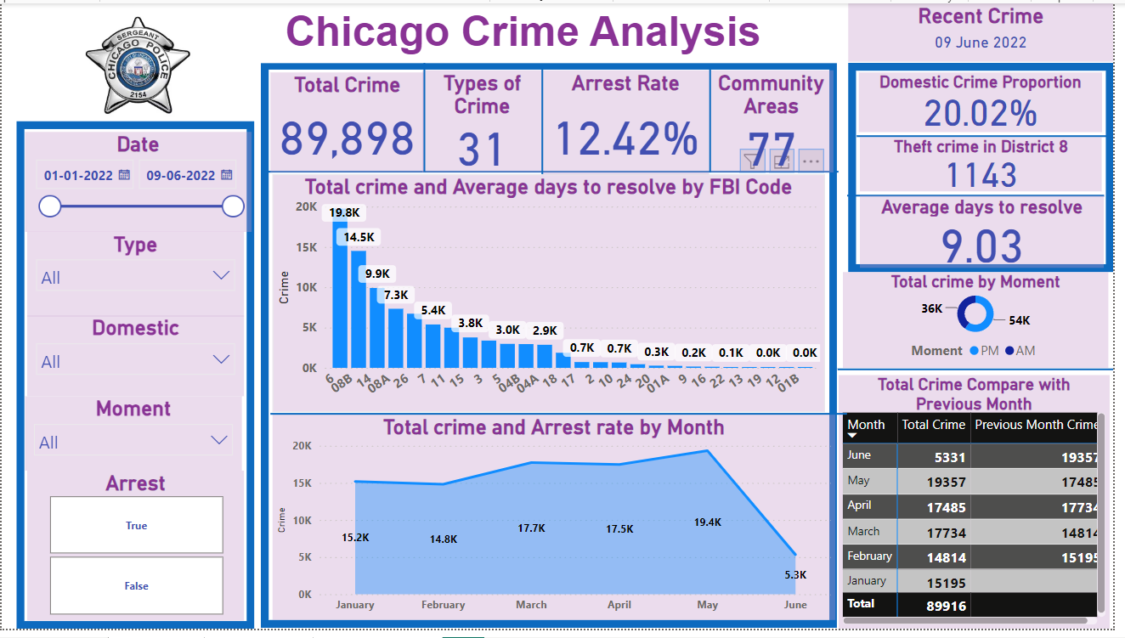
Dashboard :-
Main Tab :-

Slide 10
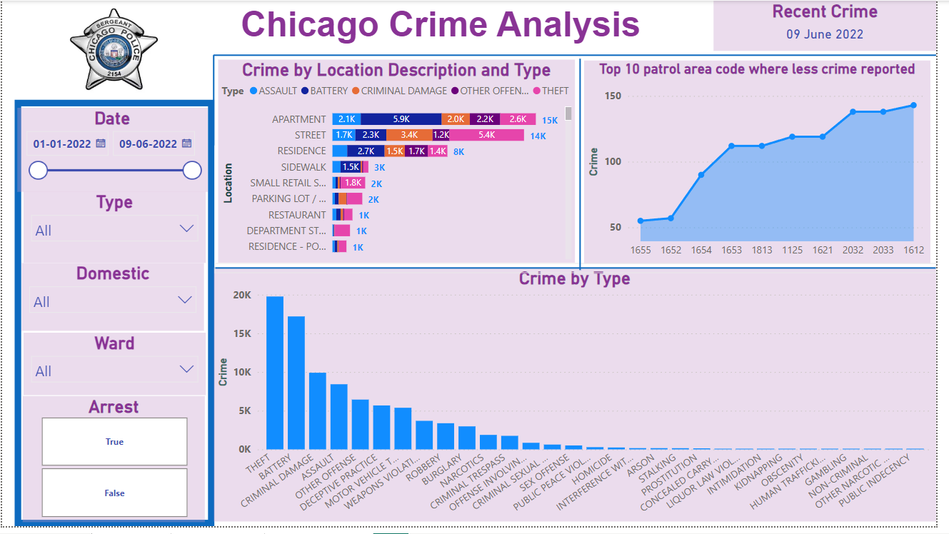
Locality Tab :-

Slide 11
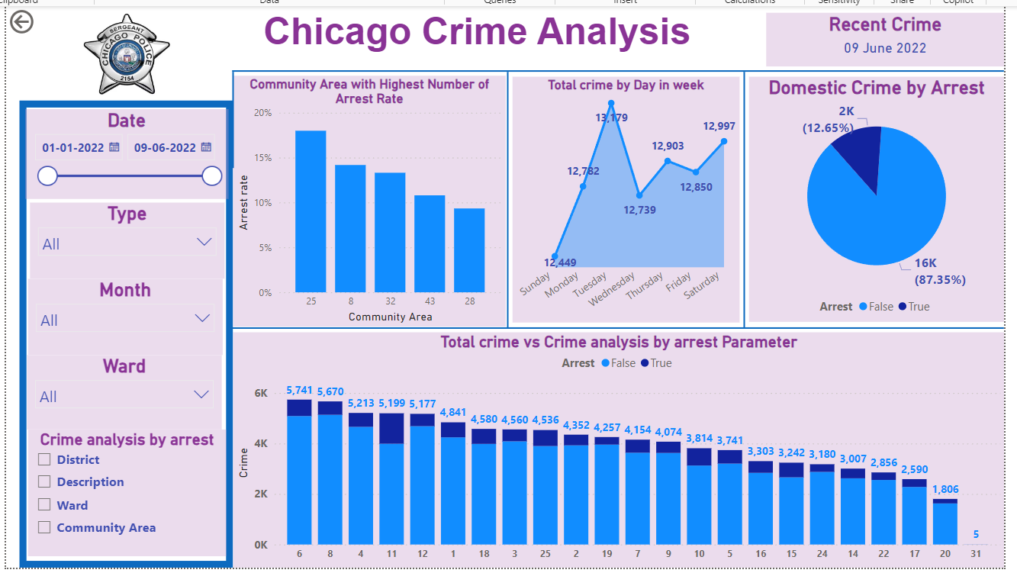
Exploration Tab :-

Slide 12

THANK YOU..!

